Slide 1
IMPORT MASTER DATA

Slide 2


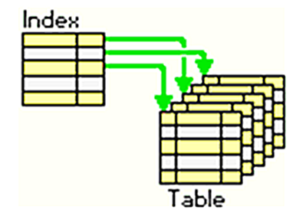
Vấn đề thường gặp
Performance
Validation
Index

Slide 3
Performance
background job
Insert số lượng lớn / 1 lần

Slide 4
Activerecord-import
- Insert số lượng lớn bản ghi dùng ActiveRecord
- Tương thích Rails 3.x trở lên

Slide 5
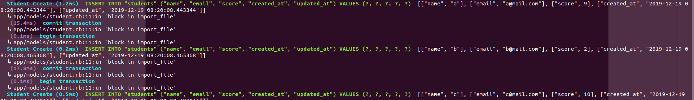
Activerecord-import
Sử dụng
Không sử dụng

Slide 6
Activerecord-import
Student Create Many Without Validations Or Callbacks (0.8ms)
INSERT INTO "students" ("name","email","score","created_at","updated_at") VALUES ('a','a@mail.com',9,'',''), ('b','b@mail.com',2,'',''), ('c','c@mail.com',10,'','')
Student Create (1.2ms)
INSERT INTO "students" ("name", "email", "score", "created_at", "updated_at") VALUES (?, ?, ?, ?, ?) [["name", "a"], ["email", "a@mail.com"], ["score", 9], ["created_at", "2019-12-19 06:24:09.374473"], ["updated_at", "2019-12-19 06:24:09.374473"]]
Student Create (0.5ms)
INSERT INTO "students" ("name", "email", "score", "created_at", "updated_at") VALUES (?, ?, ?, ?, ?) [["name", "b"], ["email", "b@mail.com"], ["score", 2], ["created_at", "2019-12-19 06:24:09.403464"], ["updated_at", "2019-12-19 06:24:09.403464"]]
Student Create (0.2ms)
INSERT INTO "students" ("name", "email", "score", "created_at", "updated_at") VALUES (?, ?, ?, ?, ?) [["name", "c"], ["email", "c@mail.com"], ["score", 10], ["created_at", "2019-12-19 06:24:09.422780"], ["updated_at", "2019-12-19 06:24:09.422780"]]

